Slide 1
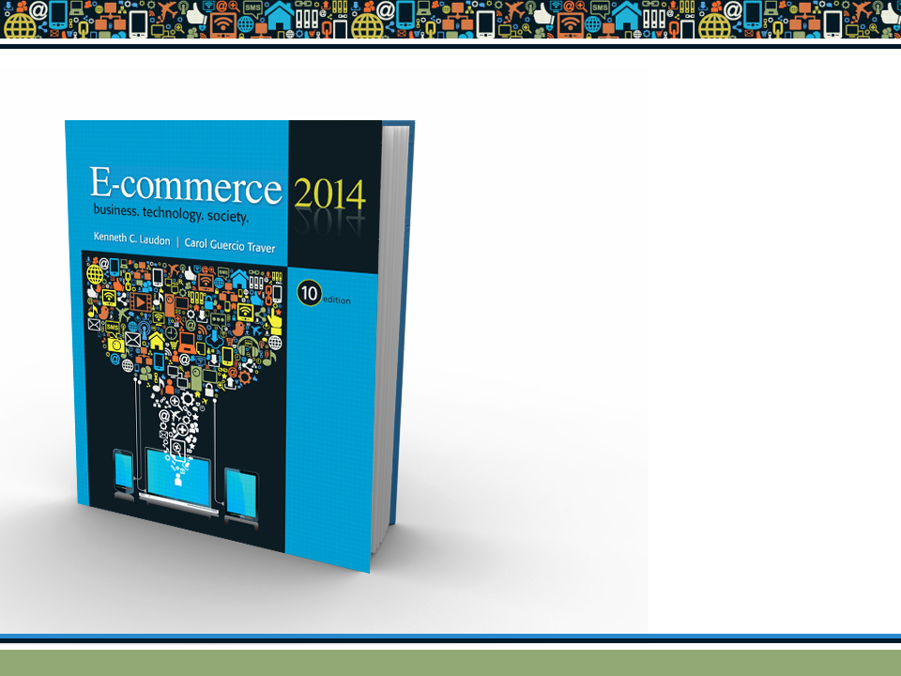
Copyright © 2014 Pearson Education, Inc. Publishing as Prentice Hall

Slide 2
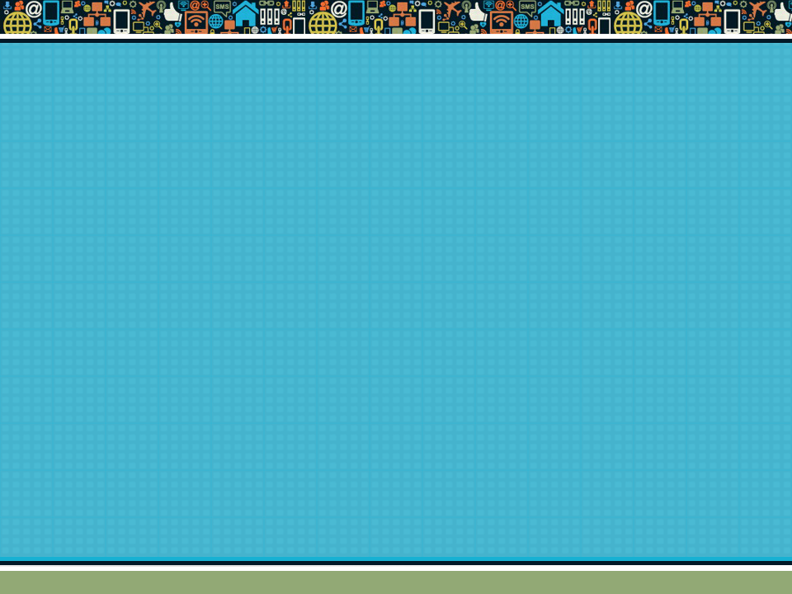
Chapter 6
E-commerce Marketing and Advertising Concepts
Copyright © 2014 Pearson Education, Inc. Publishing as Prentice Hall

Slide 3

Video Ads: Shoot, Click, Buy
What advantages do video ads have over traditional banner ads?
Where do sites such as YouTube fit in to a marketing strategy featuring video ads?
What are some of the challenges and risks of placing video ads online?
Do you think Internet users will ever develop “blindness” toward video ads as well?
Copyright © 2014 Pearson Education, Inc. Publishing as Prentice Hall
Slide 6-<number>

Slide 4
Consumers Online: The Internet
Audience and Consumer Behavior
Around 70% (85 million) U.S. households have broadband Internet access in 2013
Growth rate has slowed
Intensity and scope of use both increasing
Some demographic groups have much higher percentages of online usage than others
  Income, education, age, ethnic dimensions
Copyright © 2014 Pearson Education, Inc. Publishing as Prentice Hall
Slide 6-<number>

Slide 5
Consumers Online (cont.)
Broadband vs. dial-up audiences
  50% of Hispanic and African-American homes have broadband
  40% of households with less than $20k in annual income have broadband
Neighborhood effects
  Role of social emulation in consumption decisions
  “Connectedness”
    Top 10–15% are more independent
    Middle 50% share more purchase patterns of friends
  Recommender systems
Copyright © 2014 Pearson Education, Inc. Publishing as Prentice Hall
Slide 6-<number>

Slide 6
Consumer Behavior
Study of consumer behavior
  Attempts to explain what consumers purchase and where, when, how much, and why they buy
Consumer behavior models
  Attempt to predict or explain wide range of consumer decisions
  Based on background demographic factors and other intervening, more immediate variables
Profiles of Online Consumers
  Consumers shop online primarily for convenience
Copyright © 2014 Pearson Education, Inc. Publishing as Prentice Hall
Slide 6-<number>

Slide 7
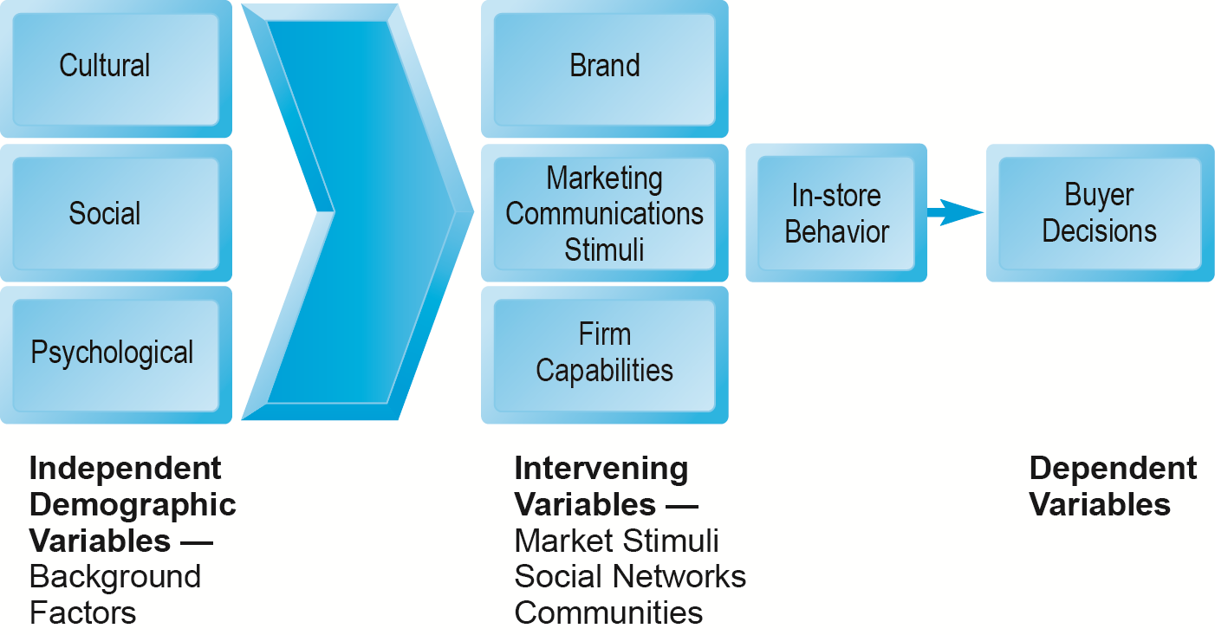
A General Model of Consumer Behavior
Figure 6.1, Page 333
SOURCE: Adapted from Kotler and Armstrong, 2009.
Copyright © 2014 Pearson Education, Inc. Publishing as Prentice Hall
Slide 6-<number>

Slide 8
The Online Purchasing Decision
Five stages in consumer decision process
  Awareness of need
  Search for more information
  Evaluation of alternatives
  Actual purchase decision
  Post-purchase contact with firm
Copyright © 2014 Pearson Education, Inc. Publishing as Prentice Hall
Slide 6-<number>

Slide 9
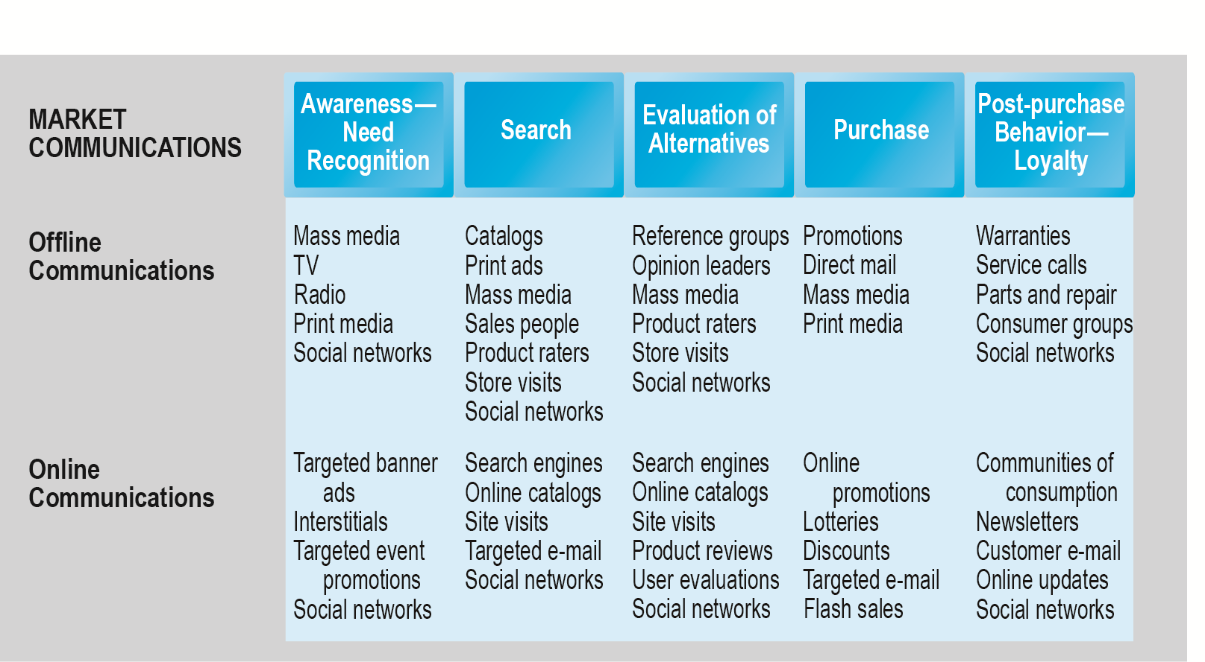
The Consumer Decision Process and
Supporting Communications
Figure 6.2, Page 334
Copyright © 2014 Pearson Education, Inc. Publishing as Prentice Hall
Slide 6-<number>

Slide 10
The Online Purchasing Decision (cont.)
Decision process similar for online and offline behavior
General online behavior model
  Consumer skills
  Product characteristics
  Attitudes toward online purchasing
  Perceptions about control over Web environment
  Web site features: latency, usability, security
Clickstream behavior
Copyright © 2014 Pearson Education, Inc. Publishing as Prentice Hall
Slide 6-<number>

Slide 11
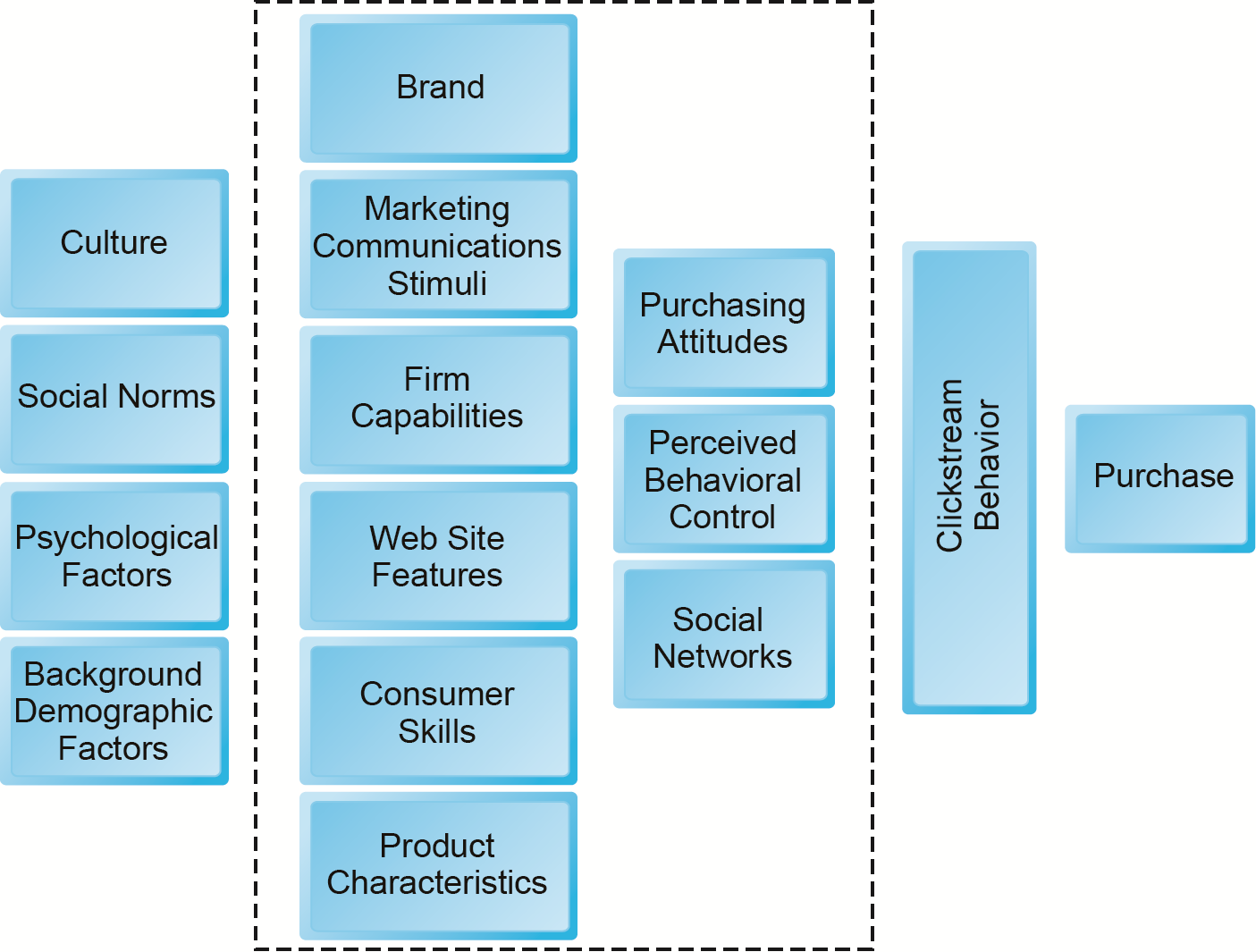
A Model of Online Consumer Behavior
Figure 6.3, Page 335
Copyright © 2014 Pearson Education, Inc. Publishing as Prentice Hall
Slide 6-<number>

Slide 12
Shoppers: Browsers and Buyers
Shoppers: 89% of Internet users
  73% buyers
  16% browsers (purchase offline)
One-third of offline retail purchases influenced by online activities
Online traffic also influenced by offline brands and shopping
E-commerce and traditional commerce are coupled: Part of a continuum of consuming behavior
Copyright © 2014 Pearson Education, Inc. Publishing as Prentice Hall
Slide 6-<number>

Slide 13
What Consumers Shop for and
Buy Online
Big ticket items ($1000 or more)
  Travel, computer hardware, electronics
  Consumers now more confident in purchasing costlier items
Small ticket items ($100 or less)
  Apparel, books, office supplies, software, and so on
Types of purchases depend on level of experience with the Web
Copyright © 2014 Pearson Education, Inc. Publishing as Prentice Hall
Slide 6-<number>

Slide 14
How Consumers Shop
How shoppers find online vendors
  Search engines
  Marketplaces (Amazon, eBay)
  Specific retail site
27% of Internet users don’t shop online
  Trust factor
  Hassle factors (shipping costs, returns, etc.)
Copyright © 2014 Pearson Education, Inc. Publishing as Prentice Hall
Slide 6-<number>

Slide 15
Trust, Utility, and Opportunism
in Online Markets
Two most important factors shaping decision to purchase online:
  Utility:
    Better prices, convenience, speed
  Trust:
    Most important factors: Perception of credibility, ease of use, perceived risk
    Sellers can develop trust by building strong reputations for honesty, fairness, delivery
Copyright © 2014 Pearson Education, Inc. Publishing as Prentice Hall
Slide 6-<number>

Slide 16
Digital Commerce Marketing and Advertising: Strategies and Tools
Internet marketing (vs. traditional)
  More personalized
  More participatory
  More peer-to-peer
  More communal
The most effective Internet marketing has all four features
Copyright © 2014 Pearson Education, Inc. Publishing as Prentice Hall
Slide 6-<number>

Slide 17
Multi-Channel Marketing Plan
Web site
Traditional online marketing
  Search engine, display, e-mail, affiliate
Social marketing
  Social networks, blogs, video, game
Mobile marketing
  Mobile/tablet sites, apps
Offline marketing
  Television, radio, newspapers
Copyright © 2014 Pearson Education, Inc. Publishing as Prentice Hall
Slide 6-<number>

Slide 18
Online Advertising
Online advertising
  Display, search, mobile messaging, sponsorships, classifieds, lead generation, e-mail
  Fastest growing form of advertising
  Advantages:
    18–34 audience is online
    Ad targeting
    Price discrimination
    Personalization
Copyright © 2014 Pearson Education, Inc. Publishing as Prentice Hall
Slide 6-<number>

Slide 19
Traditional Online Marketing and Advertising Tools
Search engine marketing and advertising
Display ad marketing
E-mail marketing
Affiliate marketing
Viral marketing
Lead generation marketing
Social, mobile, and local marketing and advertising
Copyright © 2014 Pearson Education, Inc. Publishing as Prentice Hall
Slide 6-<number>

Slide 20
Search Engine Marketing and Advertising
Search engine marketing (SEM)
  Use of search engines for branding
Search engine advertising
  Use of search engines to support direct sales
Types of search engine advertising
  Sponsored links (keyword paid inclusion)
  Keyword advertising
  Network keyword advertising (context advertising)
Copyright © 2014 Pearson Education, Inc. Publishing as Prentice Hall
Slide 6-<number>

Slide 21
Search Engine Marketing (cont.)
Search engine optimization (SEO)
Social search
  Utilizes social graph (friend’s recommendations, past Web visits, Facebook Likes, Google +1’s) to provide fewer and more relevant results
Search engine issues
  Paid inclusion and placement practices
  Link farms
  Content farms
  Click fraud
Copyright © 2014 Pearson Education, Inc. Publishing as Prentice Hall
Slide 6-<number>

Slide 22
Display Ad Marketing
Banner ads
Rich media ads
Video ads
Sponsorships
Advertising networks
Advertising exchanges and real-time bidding
Copyright © 2014 Pearson Education, Inc. Publishing as Prentice Hall
Slide 6-<number>

Slide 23
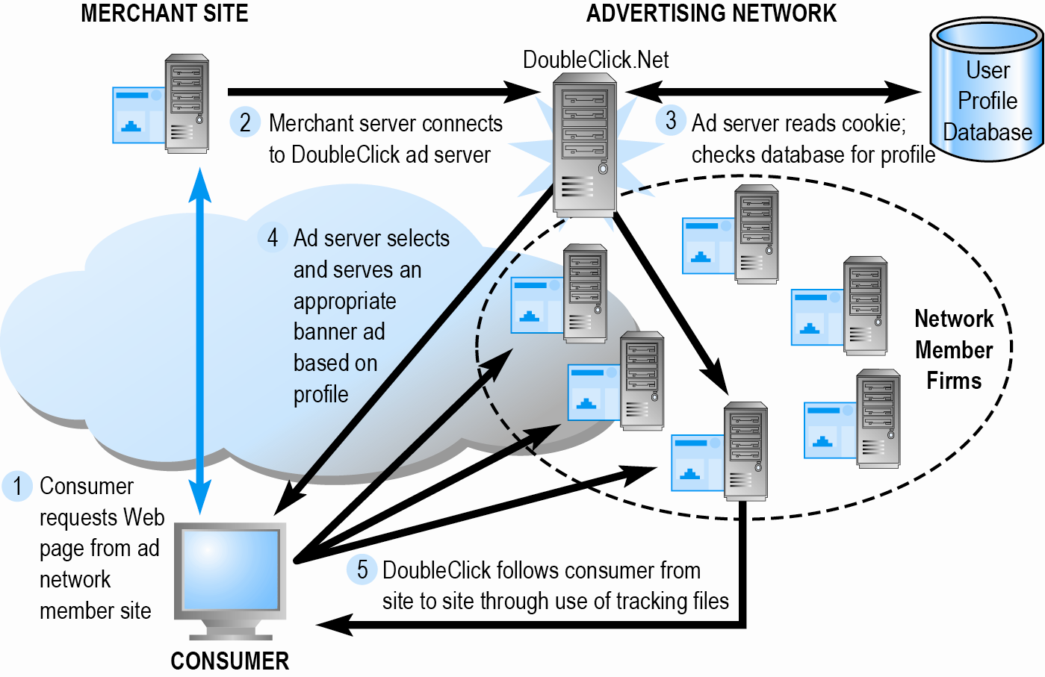
How an Advertising Network
Such as DoubleClick Works
Figure 6.7, Page 352
Copyright © 2014 Pearson Education, Inc. Publishing as Prentice Hall
Slide 6-<number>

Slide 24
E-mail Marketing
Direct e-mail marketing
  Messages sent directly to interested users
  Benefits include
    Inexpensive
    Average more than 7% click-throughs for in-house lists
    Measuring and tracking responses
    Personalization of messages and offers
Three main challenges
  Spam
  Anti-spam software
  Poorly targeted purchased e-mail lists
Copyright © 2014 Pearson Education, Inc. Publishing as Prentice Hall
Slide 6-<number>

Slide 25
Other Types of Traditional Online Marketing
Affiliate marketing
  Commission fee paid to other Web sites for sending customers to their Web site
Viral marketing
  Marketing designed to inspire customers to pass message to others
Lead generation marketing
  Services and tools for collecting, managing, and converting leads
Copyright © 2014 Pearson Education, Inc. Publishing as Prentice Hall
Slide 6-<number>

Slide 26
Social Marketing and Advertising
Fastest growing type of online marketing
Targets the enormous audiences of social networks
Four features driving growth
  Social sign-on
  Collaborative shopping
  Network notification
  Social search (recommendation)
Copyright © 2014 Pearson Education, Inc. Publishing as Prentice Hall
Slide 6-<number>

Slide 27
Social Marketing and Advertising (cont.)
Blog marketing
  Educated, higher-income audience
  Ideal platform to start viral campaign
Game marketing
  Large audiences for social games (FarmVille, Words with Friends)
  Used for branding and driving customers to purchase moments at restaurants and retail stores
Copyright © 2014 Pearson Education, Inc. Publishing as Prentice Hall
Slide 6-<number>

Slide 28
Mobile Marketing and Advertising
7% of online marketing, growing rapidly
Major formats:
  Display, rich media, video
  Games
  E-mail
  Text messaging (SMS)
  In-store messaging
  Quick Response (QR) codes
  Couponing
App marketing
Copyright © 2014 Pearson Education, Inc. Publishing as Prentice Hall
Slide 6-<number>

Slide 29
Local Marketing
Geared to user’s geographic location
  Local search and purchasing
Local searches:
  25% of all searches
  50% of mobile searches
Most common local marketing tools
  Geotargeting with Google Maps
  Display ads in hyperlocal publications
Copyright © 2014 Pearson Education, Inc. Publishing as Prentice Hall
Slide 6-<number>

Slide 30
Pricing Strategies
Pricing
  Integral part of marketing strategy
  Traditionally based on:
    Fixed cost
    Variable costs
    Demand curve
Price discrimination
  Selling products to different people and groups based on willingness to pay
Copyright © 2014 Pearson Education, Inc. Publishing as Prentice Hall
Slide 6-<number>

Slide 31
Pricing Strategies (cont.)
Free and freemium
  Can be used to build market awareness
Versioning
  Creating multiple versions of product and selling essentially same product to different market segments at different prices
Bundling
  Offers consumers two or more goods for one price
Dynamic pricing:
  Auctions
  Yield management
  Flash marketing
Copyright © 2014 Pearson Education, Inc. Publishing as Prentice Hall
Slide 6-<number>

Slide 32
Internet Marketing Technologies
Internet’s main impacts on marketing:
  Scope of marketing communications broadened
  Richness of marketing communications increased
  Information intensity of marketplace expanded
  Always-on mobile environment expands marketing opportunities
Copyright © 2014 Pearson Education, Inc. Publishing as Prentice Hall
Slide 6-<number>

Slide 33
Web Transaction Logs
Built into Web server software
Record user activity at Web site
Provides much marketing data, especially combined with:
  Registration forms
  Shopping cart database
Answers questions such as:
  What are major patterns of interest and purchase?
  After home page, where do users go first? Second?
Copyright © 2014 Pearson Education, Inc. Publishing as Prentice Hall
Slide 6-<number>

Slide 34
Tracking Files
Users browsing tracked as they move from site to site
Four types of tracking files
  Cookies
    Small text file placed by Web site
    Allows Web marketers to gather data
  Flash cookies
  Beacons (“bugs”)
  Apps
Copyright © 2014 Pearson Education, Inc. Publishing as Prentice Hall
Slide 6-<number>

Slide 35
Databases
Database: Stores records and attributes
Database management system (DBMS):
  Software used to create, maintain, and access databases
SQL (Structured Query Language):
  Industry-standard database query and manipulation language used in a relational database
Relational database:
  Represents data as two-dimensional tables with records organized in rows and attributes in columns; data within different tables can be flexibly related as long as the tables share a common data element
Copyright © 2014 Pearson Education, Inc. Publishing as Prentice Hall
Slide 6-<number>

Slide 36
Data Warehouses and Data Mining
Data warehouse:
  Collects firm’s transactional and customer data in single location for offline analysis by marketers and site managers
Data mining:
  Analytical techniques to find patterns in data, model behavior of customers, develop customer profiles
    Query-driven data mining
    Model-driven data mining
    Rule-based data mining
Copyright © 2014 Pearson Education, Inc. Publishing as Prentice Hall
Slide 6-<number>

Slide 37
Customer Relationship
Management (CRM) Systems
Create customer profiles:
  Product and usage summary data
  Demographic and psychographic data
  Profitability measures
  Contact history
  Marketing and sales information
Customer data used to:
  Develop and sell additional products
  Identify profitable customers
  Optimize service delivery, and so on
Copyright © 2014 Pearson Education, Inc. Publishing as Prentice Hall
Slide 6-<number>

Slide 38
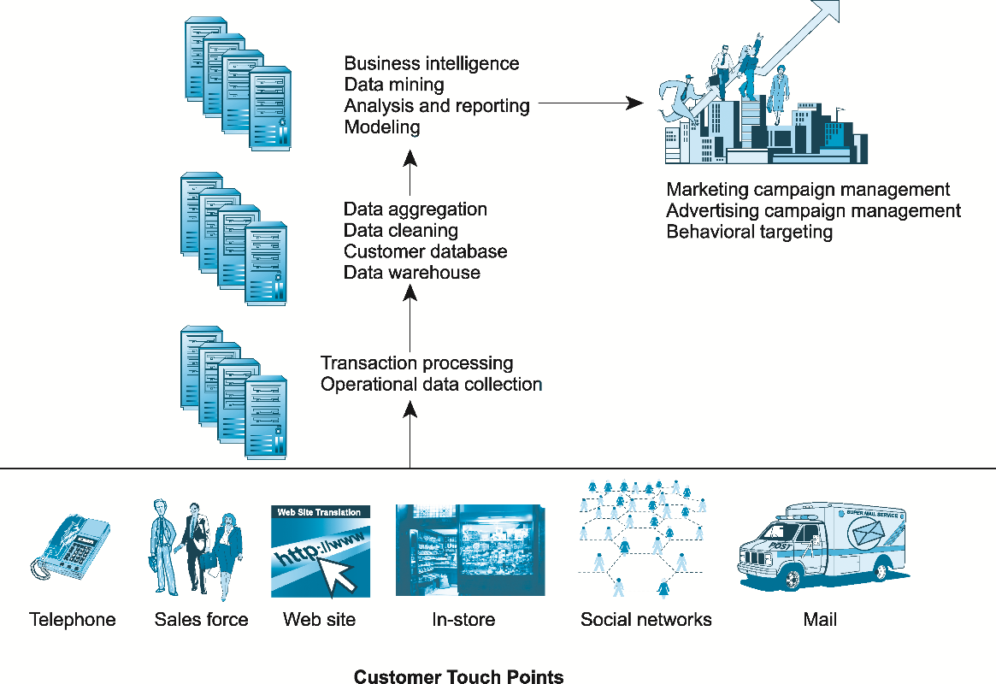
A CRM System
Figure 6.10, Page 387
Copyright © 2014 Pearson Education, Inc. Publishing as Prentice Hall
Slide 6-<number>

Slide 39
Online Marketing Metrics: Lexicon
Audience size or market share
  Impressions
  Click-through rate (CTR)
  View-through rate (VTR)
  Hits
  Page views
  Stickiness (duration)
  Unique visitors
  Loyalty
  Reach
  Recency
Conversion to customer
  Acquisition rate
  Conversion rate
  Browse-to-buy ratio
  View-to-cart ratio
  Cart conversion rate
  Checkout conversion rate
  Abandonment rate
  Retention rate
  Attrition rate
Copyright © 2014 Pearson Education, Inc. Publishing as Prentice Hall
Slide 6-<number>

Slide 40
How Well Does Online
Advertising Work?
Use ROI to measure ad campaign
Highest click-through rates: Search engine ads, permission e-mail campaigns
Rich media, video interaction rates high
Online channels compare favorably with traditional
Most powerful marketing campaigns use multiple channels, including online, catalog, TV, radio, newspapers, stores
Copyright © 2014 Pearson Education, Inc. Publishing as Prentice Hall
Slide 6-<number>

Slide 41
The Costs of Online Advertising
Pricing models
  Barter
  Cost per thousand (CPM)
  Cost per click (CPC)
  Cost per action (CPA)
Online revenues only
  Sales can be directly correlated
Both online/offline revenues
  Offline purchases cannot always be directly related to online campaign
In general, online marketing is more expensive on CPM basis, but more effective
Copyright © 2014 Pearson Education, Inc. Publishing as Prentice Hall
Slide 6-<number>

Slide 42
Copyright © 2014 Pearson Education, Inc. Publishing as Prentice Hall
Slide 6-<number>

